Slide 1
What is WebService?
Web Services is the mechanism or the medium of communication through which two applications / machines will exchange the data irrespective of their underline architecture and the technology.
A web service is any piece of software that makes itself available over the internet and uses a standardized XML messaging system. XML is used to encode all communications to a web service. For example, a client invokes a web service by sending an XML message, then waits for a corresponding XML response.
Why is WebService Needed?
In general, software applications are developed to be consumed by the human beings, where a person sends a request to a software service which in-turn returns a response in human readable format.
In the modern era of technology if you want to build a software application you don't need to build each and everything from scratch. There are lots of readymade services available which you can plug into your application and you can start providing those services in your application.
For example you want to display weather forecast information you don't need to collect, process and render the data in your application. You can buy the services from the people who already well-established in processing and publishing such kind of data.
Web services allow us to do these kind of implementations.
As an example, consider the following WebService (slide no 8 conti..)

Slide 2
Web Service Structure
Web Services are application components that communicate using open protocols; they are self-contained, self-describing, and can be used by other applications. Web Services have a service descriptor file that distinguishes their methods from the structure of the messages they exchange. The service requestor can use this information to interact with a spe cific "Web Service Provider".
You can think of an individual Web Service as a piece of software that performs a specific task (also known as a function), and makes that task available by exposing a set of operations that can be performed (known as methods or "Web Methods") with the task.
Additionally, each of the methods exposes a set of variables that can accept data passed into the method. These variables are known as parameters or properties. Together, the properties and methods refer to a Web Service's interface.

Slide 3
Web Service Structure Example
For example, "Company A" creates a Web Service that provides currency rate functionality, which may expose a method called "GetRate". "Company B" is then able to pass a parameter, called "CountryCode", into the "GetRate" method. The "GetRate" method takes the "CountryCode" parameter, looks up the appropriate currency rate in a database, and returns the rate back to the program that requested it.
In this example, which database did "Company A" use to access the currency rate information? What was the name of the database server? What communication mechanisms and security mechanisms were used to access the database server? The answer to all of these questions is, "It doesn't matter."
The beauty of a Web Service is the concept of encapsulation. Encapsulation allows the complexity of retrieving the actual currency rate to be completely self-contained within the company that created the Web Service, "Company A". The only thing that "Company B" knows is that they called a Web Service to get a currency rate and it was given to them.
Web Services are made possible by placing the programs, or applications, on a "Web Server". Since the application resides on a Web Server, it can be called, or invoked, from any other computer on the network by using "HTTP". The Web Service provides seamless distributes computing across the entire network, as long as both sides know how to use a Web Service.

Slide 4
Expose a Web Service
A Web Service must be exposed in order to be available from other Web applications and to comply with the W3C specification. Exposing a Web Service means that a programmer creates the interface for it.
There are mainly two ways to expose a Web Service:
"SOAP"
"REST"
Service View (ex. EmployeesWebServices)
Web Services must be modeled in a dedicated view of the project, which is the "Service View".
A "Service View" is a container of Web Services and scheduled operations models made available by the application. You can have several "Service Views" in the same Web Project. Each "Service View" is considered a Web Service containing different methods and is represented as a new tab in the Web Project.
What is consuming a Web service?
"Consume" means that the Web service successfully fulfills the web client's request. Context of Use: An end user performs a task on a web client that requires consumption of a Web service

Slide 5
Web Service Skeleton
Once you have a "Service View" and at least one "Port", you can start modeling your first Web Service. Let’s suppose you want to expose a Web Service that contains a method letting the service requestor search for employees. The method receives the values provided as search criteria and gives back the list of employees matching the criteria. This is how the model of the Web Service method appears.
All Web Service methods can be modeled using the same skeleton. There is an entry point, which is the "Solicit" operation, and two exit points, one for success and the other for error. The success exit point is modeled with a "Response" operation and the error exit point is modeled with an "Error Response" operation. Between the entry point and the exit point is the business logic that calculates the Web Service response. Here you can use any operation provided by WebRatio Platform. Let’s see in detail how each dedicated Web Service operation works.

Slide 6
Solicit Operation
The "Solicit" operation is the entry point of the Web Service method. Its name is the name of the method. It defines the structure of the Web Service request for the specific method.
This operation has several properties:
"Invocation Style". The "Invocation Style" property let you choose whether you want to expose the Web Service method using SOAP XML or REST. The choice affects also the structure of the request.
"Stateful". The "Stateful" property enables the session usage in the Web Service. This means that you can use volatile entities in the operation chain. This property can be used only when the "Invocation Style" is set to REST. In fact, when using SOAP, you do not have a user session.
"Protected". The "Protected" property activates user authentication on the Web Service.
If you choose the "REST" option as "Invocation Style", two other properties are available:
"Request Method". The "Request Method" property lets you choose whether you want to expose the REST Web Service using the "GET"," POST", "PUT" or "DELETE" method.
"Content Type". The "Content Type" property let you choose whether you want to use the XML or JSON request type as the structure.
The "Solicit" operation can also be configured by creating the request message that calls the Web Service correctly.

Slide 7
Response Operation
The "Response" operation is the Exit Point of the Web Service method used when the business logic contained in the method is executed properly. It defines the structure of the XML or JSON response for the method.
The "Response" operation can also be configured by creating the desired response message.
Error Response Operation
The "Error Response" operation is the Exit Point of the Web Service method used when the business logic contained in the method fails. It defines the structure of the XML or JSON response for the method, in case of exceptions.
The "Error Response" operation can also be configured by creating the desired response message.
Create Messages on Solicit, Response and Error Response Operation
"Solicit", "Response" and "Error Response" operations share the way in which the message is modeled on the operation itself.
You can use different elements to create the message structure.
"Body Parameters"
"Simple Fragments"
"Complex Fragments"
"Query String Parameters"
Only for the REST request, it’s possible to use the "Query String Parameters".

Slide 8
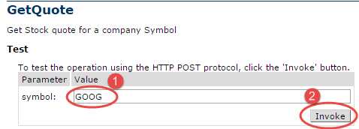
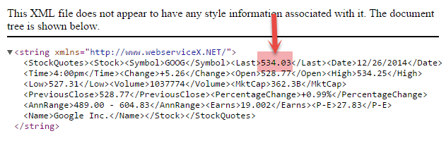
The response XML gives the stock price.
This WebService can be called by a Software Application using SOAP or HTTP protocol.
Web Services can be implemented in different ways, but the following two are the popular implementations approaches.
SOAP (Simple Object Access Protocol)
REST (Representational State Transfer architecture)
http://www.webservicex.net/stockquote.asmx?op=GetQuote
It gives Share Value for a Company.
Let's find share price for Google (Symbol: GOOG )
The response XML gives the stock price.
The response XML gives the stock price.

Slide 9
his WebService can be called by a Software Application using SOAP or HTTP protocol.
Web Services can be implemented in different ways, but the following two are the popular implementations approaches.
SOAP (Simple Object Access Protocol)
REST (Representational State Transfer architecture)
SOAP
SOAP is a standard protocol defined by the W3C Standard for sending and receiving web service requests and responses.
SOAP uses the XML format to send and receive the request and hence the data is platform independent data. SOAP messages are exchanged between the provider applications and receiving application within the SOAP envelops.
As SOAP uses the simple http transport protocol, its messages are not got blocked by the firewalls.

Slide 10
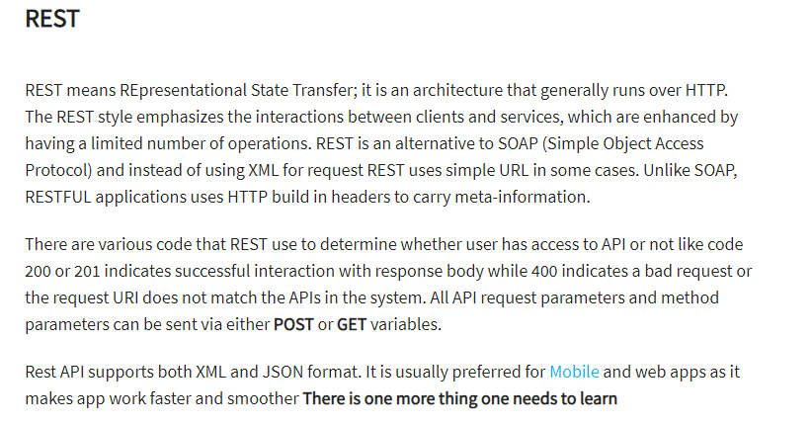
REST is an architecture, which inherently uses servlets.
No, it is not. REST is an architecture style which can be implemented using servlets, but does not inherently use them, nor inherently have anything to do with Java.

Slide 11
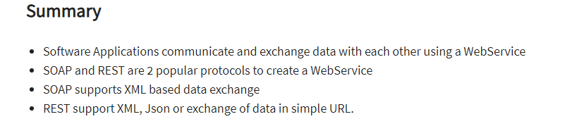
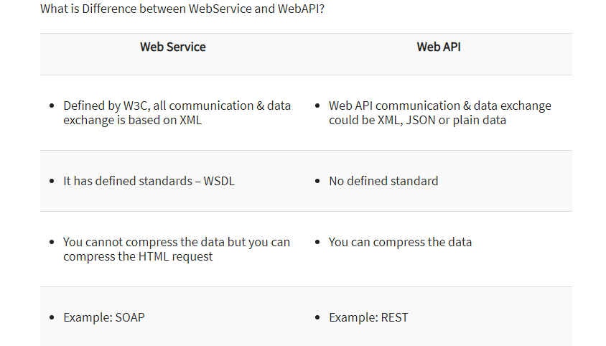

Slide 12
1) Explain what is REST and RESTFUL?
REST represents REpresentational State Transfer; it is a relatively new aspect of writing web API.
RESTFUL is referred for web services written by applying REST architectural concept are called RESTful services, it focuses on system resources and how state of resource should be transported over HTTP protocol to different clients written in different language. In RESTFUL web service HTTP methods like GET, POST, PUT and DELETE can be used to perform CRUD operations.
REST APIs are based on URIs (uniform resource identifier) and the HTTP protocol. REST APIs can exchange data in either JSON or XML format, although many REST APIs send data as JSON.
7) Mention some key characteristics of REST?
Some key characteristics of REST includes
REST is stateless, therefore the SERVER has no state (or session data)
With a well-applied REST API, the server could be restarted between two calls as every data is passed to the server
Web service mostly uses POST method to make operations, whereas REST uses GET to access resources

Slide 13
6) Mention what are resources in a REST architecture?
Resources are identified by logical URLs; it is the key element of a RESTful design. Unlike, SOAP web services in REST, you view the product data as a resource and this resource should contain all the required information.
REST architecture treats every content as a resource. These resources can be Text Files, Html Pages, Images, Videos or Dynamic Business Data. REST Server simply provides access to resources and REST client accesses and modifies the resources.
Q #10) What is a ‘Resource’?
Just like the ‘Object’ instance, we have learned in object orient programming Language, in the same way, ‘Resource’ is defined as an object of a type which can be an image, HTML file, text data, and any type of dynamic data. There are varieties of representation formats available in order to represent a resource.
Some most common are enlisted below:
JSON
YAML
XML
HTML

Slide 14
2) Explain the architectural style for creating web API?
The architectural style for creating web api are
HTTP for client server communication
XML/JSON as formatting language
Simple URI as the address for the services
Stateless communication
3) Mention what tools are required to test your web API?
SOAPUI tool for SOAP WS and Firefox "poster" plugin for RESTFUL services.
4) Mention what are the HTTP methods supported by REST?
HTTP methods supported by REST are:
GET: It requests a resource at the request URL. It should not contain a request body as it will be discarded. Maybe it can be cached locally or on the server.
POST: It submits information to the service for processing; it should typically return the modified or new resource
PUT: At the request URL it update the resource
DELETE: At the request URL it removes the resource
OPTIONS: It indicates which techniques are supported
HEAD: About the request URL it returns meta information
5) Mention whether you can use GET request instead of PUT to create a resource?
No, you are not supposed to use POST or GET. GET operations should only have view rights

Slide 15
HTTP GET
Use GET requests to retrieve resource representation/information only – and not to modify it in any way. As GET requests do not change the state of the resource, these are said to be safe methods. Additionally, GET APIs should be idempotent, which means that making multiple identical requests must produce the same result every time until another API (POST or PUT) has changed the state of the resource on the server.
If the Request-URI refers to a data-producing process, it is the produced data which shall be returned as the entity in the response and not the source text of the process, unless that text happens to be the output of the process.
For any given HTTP GET API, if the resource is found on the server then it must return HTTP response code 200 (OK) – along with response body which is usually either XML or JSON content (due to their platform independent nature).
In case resource is NOT found on server then it must return HTTP response code 404 (NOT FOUND). Similarly, if it is determined that GET request itself is not correctly formed then server will return HTTP response code 400 (BAD REQUEST).

Slide 16
7) Mention what is the difference between AJAX and REST?
AJAX | REST
In Ajax, the request are sent to the server by using XMLHttpRequest objects. The response is used by the JavaScript code to dynamically alter the current page Ajax is a set of technology; it is a technique of dynamically updating parts of UI without having to reload the page Ajax eliminates the interaction between the customer and server asynchronously REST requires the interaction between the customer and server | REST have a URL structure and a request/response pattern the revolve around the use of resources REST is a type of software architecture and a method for users to request data or information from servers REST requires the interaction between the customer and server
JAX-RS is defined as the Java API for RESTful web service. Among multiple libraries and framework, this is considered as the most suitable Java programming language based API which supports RESTful web service.
Some of the implementations of JAX-RS are:
Jersey
RESTEasy
Apache CFX
Play
Among these, Jersey is the most popular framework.
13) Mention what is JAX-WS and JAX-RS?
Both JAX-WS and JAX-RS are libraries (APIs) for doing communication in various ways in Java. JAX-WS is a library that can be used to do SOAP communication in JAVA, and JAX-RS lets you do the REST communication in JAVA

Slide 17
14) List out the tools or API for developing or testing web api?
Testing tools for web services for REST APIs includes
Spring REST web service using MVC
Jersey API
CFX
Axis
Restlet,
10) Mention what is the difference between PUT and POST?
"PUT" puts a file or resource at a particular URI and exactly at that URI. If there is already a file or resource at that URI, PUT changes that file or resource. If there is no resource or file there, PUT makes one
POST sends data to a particular URI and expects the resource at that URI to deal with the request. The web server at this point can decide what to do with the data in the context of specified resource
PUT is idempotent meaning, invoking it any number of times will not have an impact on resources.
However, POST is not idempotent, meaning if you invoke POST multiple times it keeps creating more resources

Slide 18
15) Mention what is the difference between SOAP and REST?
SOAP | REST
SOAP is a protocol through which two computer communicates by sharing XML document SOAP permits only XML SOAP based reads cannot be cached SOAP is like custom desktop application, closely connected to the server SOAP is slower than REST It runs on HTTP but envelopes the message | Rest is a service architecture and design for network-based software architectures REST supports many different data formats REST reads can be cached A REST client is more like a browser; it knows how to standardized methods and an application has to fit inside it REST is faster than SOAP It uses the HTTP headers to hold meta information
What are safe REST operations? (answer) REST API uses HTTP methods to perform operations. Some of the HTTP operations which doesn't modify the resource at the server is known as safe operations e.g. GET and HEAD. On the other hand, PUT, POST, and DELETE are unsafe because they modify the resource on the server. Read more: https://javarevisited.blogspot.com/2018/02/top-20-spring-rest-interview-questions-answers-java.html#ixzz5uVtxUhjH

Slide 19
Is REST scalable and/or interoperable? (answer) Yes, REST is Scalable and interoperable. It doesn't mandate a specific choice of technology either at client or server end. You can use Java, C++, Python or JavaScript to create RESTful Web Services and Consume them at the client end.
What are the advantages of the RestTemplate? (answer) The RestTemplate class is an implementation of Template method pattern in Spring framework. Similar to other popular template classes e.g. JdbcTemplate or JmsTempalte, it also simplifies the interaction with RESTful Web Services on the client side. You can use it to consume a RESTful Web Servicer very easily as shown in this example. Which HTTP methods does REST use? (answer) REST can use any HTTP methods but the most popular ones are GET for retrieving a resource, POST for creating a resource, PUt for updating resource and DELETE for removing a resource from the server.

Slide 20
Is REST normally stateless? (answer) Yes, REST API should be stateless because it is based on HTTP which is also stateless. A Request in REST API should contain all the details required it to process i.e. it should not rely on previous or next request or some data maintained at the server end e.g. Sessions. REST specification put a constraint to make it stateless and you should keep that in mind while designing your REST API.
Q #4) Enlist features of RESTful web services.
Every RESTful web services should have following features and characteristics that are enlisted below:
Based on the Client Server representation.
Use of HTTP protocol for performing functions like fetching data from the web service, retrieving resources, execution of any query, etc.
The communication between the server and client is performed through the medium known as ‘messaging’.
Addressing of resources available on the server through URIs.
Based on the concept of statelessness where every client request and the response is independent of the other with complete assurance of providing required information.
Uses the concept of caching.
Works on Uniform interface.

Slide 21
Q #5) Explain messaging technique.
Messages are the mode of exchanging data for any type of communication to take place. In the same way, HTTP protocol plays the role of message communication between the client and server through HTTP Request and Response methods. HTTP request is sent by the client who contains information about the data and in turn, receives HTTP Response from the server.
Messages are the collection of information about the data i.e. Metadata.
Q #6) What are the core components of HTTP request and HTTP response?
The core components that come under HTTP Request are:
Verb: Includes methods like GET, PUT, POST, etc.
Uniform Resource Identifier for identifying the resources available on the server.
HTTP Version for specifying the HTTP version.
HTTP Request header for containing the information about the data.
HTTP Request body that contains the representation of the resources in use.
The core components that come under HTTP Response are:
Request Code: This contains various codes which determine the status of the server response.
HTTP Version for specifying the HTTP version.
HTTP Response header for containing the information about the data.
HTTP Response body that contains the representation of the resources in use.

Slide 22
Q #11) Why proper representation of Resource is required?
Representation is very important because it determines the easy identification of resources. With proper representations of resource in the proper format, allows the client to easily understand the format.
Q #12) Enlist some important points that should be kept in mind while designing Resources representation for RESTful web services.
As there are no restrictions on the format in which the resource representation is done but just that the main requirement is the format of the representation should be as per the client requirement. A good resource representation is designed by considering the following main points:
The resource representation format should be easily understood by the client and server.
The representation should be complete regardless of its format structure, which may be complex or simple.
In the case of the link of the resources to other resources, such cases should also be considered and handled.

Slide 23
Q #13) What is Caching?
Caching is the process in which server response is stored so that a cached copy can be used when required and there is no need of generating the same response again. This process not only reduces the server load but in turn increase the scalability and performance of the server. Only the client is able to cache the response and that too for a limited period of time.
Mentioned below are the header of the resources and their brief description so that they can be identified for the caching process:
Time and Date of resource creation
Time and date of resource modification that usually stores the last detail.
Cache control header
Time and date at which the cached resource will expire.
The age which determines the time from when the resource has been fetched.
Q #14) Explain Cache-control header.
A standard Cache control header can help in attaining cache ability. Enlisted below is the brief description of various cache control header:
Public: Resources that are marked as the public can be cached by any intermediate components between the client and server.
Private: Resources that are marked as private can only be cached by the client.
No cache means that particular resource cannot be cached and thus the whole process is stopped.

Slide 24
Q #15) What are the best practices that are to be followed while designing RESTful web services?
To design a secure RESTful web service, there are some best practices or say points that should be considered. These are explained as follows:
Every input on the server should be validated.
Input should be well formed.
Never pass any sensitive data through URL.
For any session, the user should be authenticated.
Only HTTP error messages should be used for indicating any fault.
Use message format that is easily understood and is required by the client.
Unified Resource Identifier should be descriptive and easily understood.
Q #16) What is Payload?
The request data which is present in the body part of every HTTP message is referred as ‘Payload’. In Restful web service, the payload can only be passed to the recipient through POST method.
There is no limit of sending data as payload through POST method but the only concern is that more data with consuming more time and bandwidth. This may consume much of user’s time also.

Slide 25
Q #20) What are HTTP status codes? Enlist few with meaning.
HTTP status codes basically are the representation of the status of the task that has been performed on the server, with the mode of some codes. Every code has their own meaning.
Some of the HTTP status codes with their meaning are as follows:
Code 200: This indicates success.
Code 201: This indicates resource has been successfully created.
Code 204: This indicates that there is no content in the response body.
Code 404: This indicates that there is no method available.
There are few more such codes that indicate the status.
we are big fans of the JSON (JavaScript Object Notation). This is because our client-side front-end technologies are mainly Javascript-based, and it becomes easier to create and parse data in this JSON format.

Slide 26
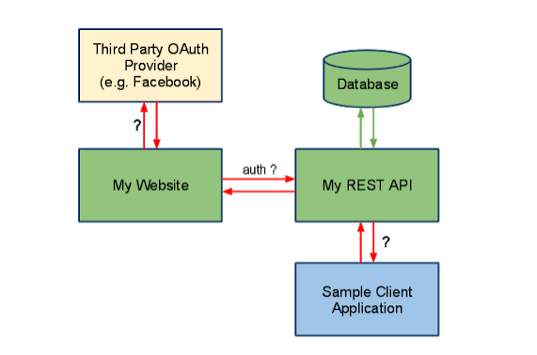
Is REST secure? What can you do to secure it? (answer) This question is mostly asked with experienced Java programmers e.g. 2 to 5 years experience with both REST and Spring. Security is a broad term, it could mean security of message which is provided by encryption or access restriction which is provided using authentication and authorization. REST is normally not secure but you can secure it by using Spring security. At the very least you can enable HTTP basic authentication by using HTTP in your Spring security configuration file. Similarly, you can expose your REST API using HTTPS if the underlying server supports HTTPS.

Slide 27
Does REST work with transport layer security (TLS)? (answer) TLS or Transport Layer Security is used for secure communication between client and server. It is the successor of SSL (Secure Socket Layer). Since HTTPS can work with both SSL and TLS, REST can also work with TLS. Actually, REST says anything about Security, it's up to the server which implements that. Same RESTful Web Service can be accessed using HTTP and HTTPS if the server supports SSL. If you are using Tomcat, you can see here to learn more about how to enable SSL in Tomcat.
Do you need Spring MVC in your classpath for developing RESTful Web Service? (answer) This question is often asked to Java programmers with 1 to 2 years of experience in Spring. Short answer is Yes, you need Spring MVC in your Java application's classpath to develop RESTful web services using Spring framework. It's actually Spring MVC which provides all useful annotations e.g. @RestController, @ResponseCode, @ResponseBody, @RequestBody, and @PathVariable, hence you must spring-mvc.jar or appropriate Maven entry in your pom.xml

Slide 28
Difference between WebSocket vs REST:
WebSocket is a communication protocol over a TCP connection, which provides point-to-point communication system. This protocol was standardized in 2011 and relevant WebSocket API is being standardized by W3C. The basic idea that WebSocket is built upon is socket or one can say that WebSocket protocol is an extension of the socket. Standardization of the protocol allowed people to use it, which was very efficient, for transferring the data to and from the server from the browser

Slide 29
EST i.e. Representational State Transfer, defines a set of constraints to be utilized for creating web services. It is one of the architectural styles, to create REST endpoints using HTTP in a web application. RESTful endpoints are being called, which would invoke APIs that too are RESTful in nature and giving an HTTP response. A request would originate from the client with the HTTP verbs i.e. Get, Post, Put, Delete. They react to the expected set of operations, receive the data, update the data or can delete the data depending upon the verb.
WebSocket protocol can overcome hurdles which were put forward by HTTP like it can provide a full duplex communication. At the same time, WebSocket does not compromise with the security system of the web. All the WebSocket handshakes can be scrutinized by the browser using embedded developer tools in them.

Slide 30
WebSocket is a low-level protocol, based on the concept of socket and port, which are the underlying transport mechanism whereas REST is based on CRUD operation.
WebSocket require the use of IP address and Port details, which are lower level details for any application whereas RESTful application needs to design operation based on verbs, and HTTP based.
WebSocket is bi-directional in nature i.e. both way operation from client to server and vice versa is possible whereas REST follows a uni-directional approach.
WebSocket approach is ideal for real-time scalable application, whereas REST is better suited for the scenario with lots of getting request.
WebSocket is a stateful protocol whereas REST is based on stateless protocol i.e. client does not need to know about the server and same hold true for the server.
WebSocket connection can scale vertically on a single server whereas REST, which is HTTP based can scale horizontally.
WebSocket is ideal for a scenario where high loads are a part of game i.e. real-time scalable chat application whereas REST is better fitted for occasional communication, in a typical GET request scenario to call RESTful APIs.
WebSocket works better, where client-server communicates over the same TCP connection for the life of web socket connection whereas, for HTTP request, a new TCP connection is initiated.

Slide 31
WebSocket communication allows client and server to talk independently of each other whereas with the REST based approach, either client is talking to the client or server is talking to the client at any given time.
WebSocket communication cost is lower whereas REST-based communication is comparatively higher end on the cost.

